Slide 1
Name : SRIHARIRAM S
Department : COMPUTER SCIENCE AND ENGINEERING
Institution : ANNA UNIVERSITY REGIONAL CAMPUS TIRUNELVELI
Project Title : IMAGE GENERATOR

Slide 2
PROJECT TITLE
IMAGE GENERATOR
An image generator uses artificial intelligence (AI) techniques to create images from text prompts Image generators use trained neural networks to create images from scratch. They use a process that translates textual data into a machine-friendly language, initiated by a Natural Language Processing (NLP) model.

Slide 3


AGENDA
PROBLEM STATEMENT
PROJECT OVERVIEW
END USERS DESCRIPTION
PROPOSED SOLUTION
VALUE PROPOSITION
ALGORITHM AND DEPLOYMENT
MODELLING
RESULTS
3/21/2024 Annual Review

Slide 4

PROBLEM STATEMENT The project aims to develop a Generative Adversial Network (GAN) capable of generating Image by using trained model and dataset. The Keras dataset consists of loaded images and it is trained with the required datas .The objective is to create a GAN that can produce synthetic images resembling these images
3/21/2024 Annual Review

Slide 5

PROJECT OVERVIEW
This project focused on generating CIFAR-10-like images using Generative Adversarial Networks (GANs). The custom GAN model consists of a Generator and a Discriminator, trained to produce realistic images and differentiate between real and generated ones. These innovative tools utilize deep learning algorithms to create images that can be used for a variety of purposes, from personal art projects to marketing campaigns.
3/21/2024 Annual Review

Slide 6

WHO ARE THE END USERS?
In an image generator project, the end users could vary depending on the purpose and scope of the project. Here are some potential end users that I have added :
General Users : Anyone who needs to create images for personal or non-commercial use could also be the end users. This could include individuals creating greeting cards, invitations, or social media graphics for personal use.
Educators : Teachers, instructors, and educational institutions could use this image generator to create visual aids, diagrams, or illustrations for educational purposes.
3/21/2024 Annual Review

Slide 7
YOUR SOLUTION AND ITS VALUE PROPOSITION
Architecture Design :
Design architecture consisting of a generator and a discriminator network using Tensor Flow/ Keras .
Generator :
Implement a neural network with multiple layers of fully connected (Dense) and activation layers.
Experiment with variations in network depth ,layer sizes , and normalization techniques like Batch Normalization .
The goal of the generator is to produce realistic-looking images
Discriminator :
The discriminator, is another neural network model that evaluates images and determines whether they are real (from the training dGAN ataset) or fake (generated by the generator).
It essentially acts as a binary classifier, assigning a probability to each input image indicating the likelihood of it being real
3/21/2024 Annual Review

Slide 8

THE WOW IN YOUR SOLUTION
Interactive User Experience:
Create an interactive and immersive user experience that goes beyond simply generating images. Implement features such as real-time previews, to engage users and make the image generation process feel intuitive and enjoyable.
Stunning Visual Outputs:
Focus on delivering visually stunning outputs that leave a lasting impression on users. Invest in realistic textures, and attention to detail to ensure that the generated images captivate and inspire viewers, eliciting that "wow" reaction with every creation.

Slide 9
MODELLING
Data Preparation :
Download the CIFAR-10 dataset
Preprocessed the images by normalizing pixel values to the range [-1 ,1]
Generator Network :
Define the generator network architecture using TensorFlow / Keras.
Implement a neural network with multiple layers of fully connected (Dense) and activation layers. and normalization techniques like Batch Normalization .
Discriminator :
The discriminator, is another neural network model that evaluates images and determines whether they are real (from the training dataset) or fake (generated by the generator).
It essentially acts as a binary classifier, assigning a probability to each input image indicating the likelihood of it being real

Slide 10
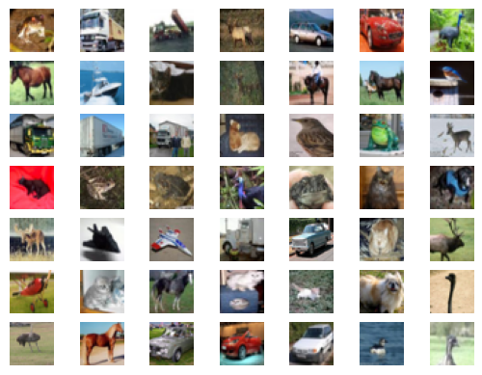
RESULTS
The project demonstrates the effectiveness of GAN in generating realistic images and provides insights into the challenges and opportunities in training and deploying generative models .

